Slide 1
Steps for making DOCENCIA database into MySQL

Slide 2
1. Implement the docencia relational model in MySQL

Slide 3
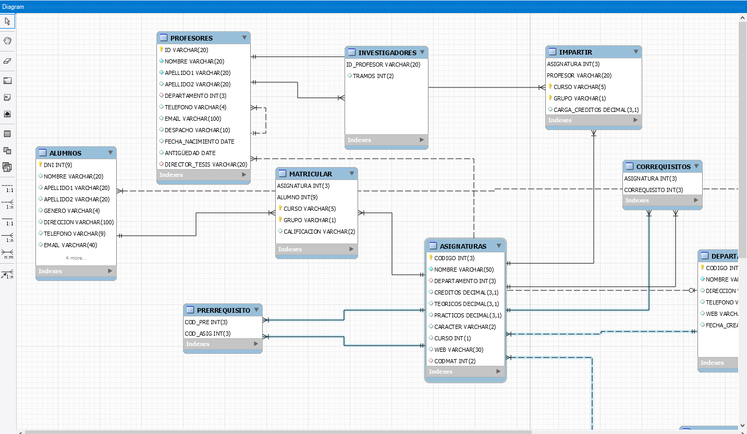
Implementing Relational Model into MySQL Workbench

Slide 4
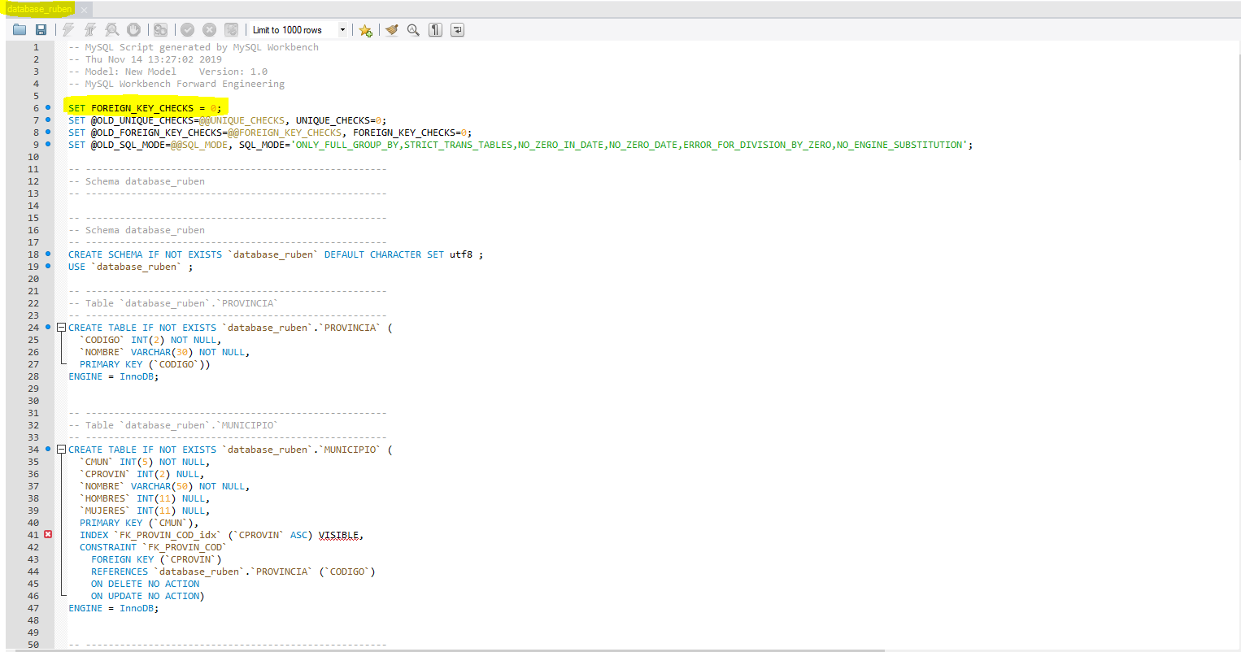
SQL script generated
I changed DOCENCIA by database_ruben
Taking into account disabling Foreign keys to upload properly (only for making the database, after that enable it)

Slide 5
2. Load all data

Slide 6
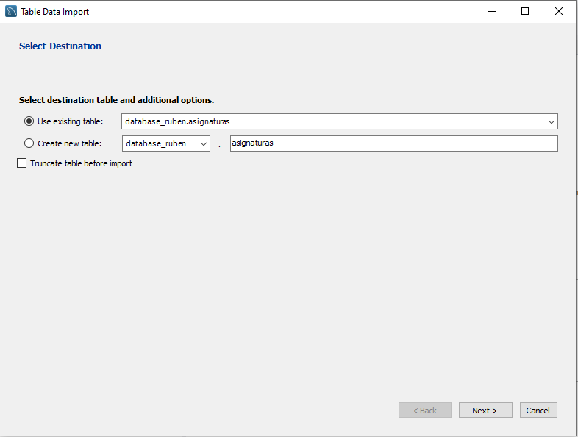
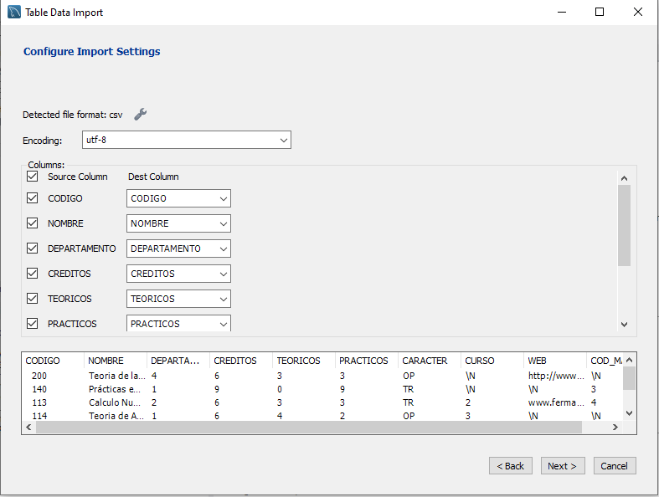
Loading data into my database
Do that for each table

Slide 7
3. Submit the MySQL project

Slide 8
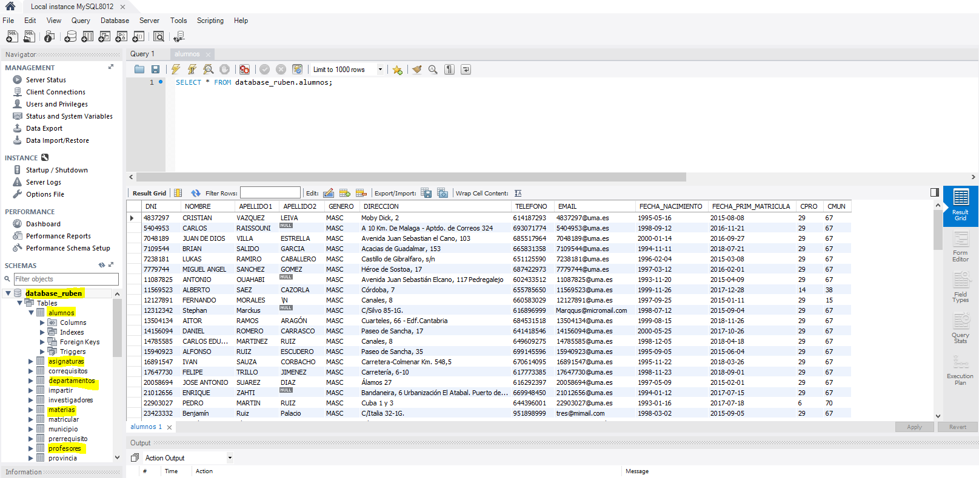
Database_ruben made and data loaded

Slide 9

Rubén Navarro Trujillo
Master en BigData & Business Intelligence
(2019-2021)

